Slide 1

Master Individual Project
Determining the Compatibility of the Network Functions of the 5G Core Implementations -Open Air Interface and Open5GS
Submitted By: Deblina Karmakar
Examined By: Prof. Dr.-Ing Ulrich Trick

Slide 2
INDEX
Problem Statement
Significance
Key Technologies
Case Studies
Specification
Observation
Overall Analysis
Future Prospective

Slide 3
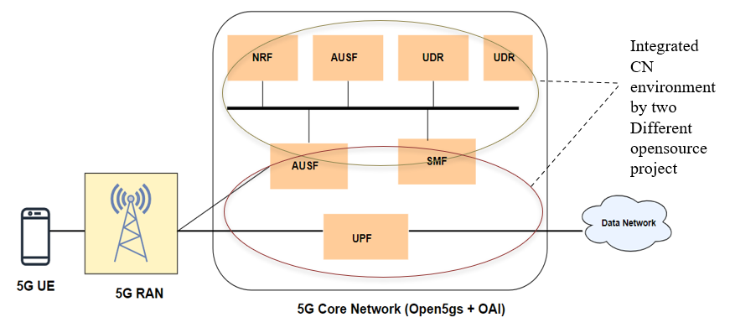
Problem Statement
Ensure compatibility and interoperability between two different 5G core network implementations
OpenAirInterface and Open5GS represent two leading open-source platforms in the 5G landscape. Both projects aims to provide a platform which facilitates the features of 5G core network that are 3GPP complaint.
Performance evaluation of NFs in an integrated environment.

Slide 4
Significance
Ensuring interoperability, crucial for creating a diverse and interoperable 5G ecosystem
Reduce dependency on a single open-source project
Fosters innovation and encourages the development of adaptable and robust 5G core network solutions.
Support for Standardization process, providing empirical data on the performance and compatibility of different 5G core network functions.
It can increase capacity and the overall reliability of the network.

Slide 5
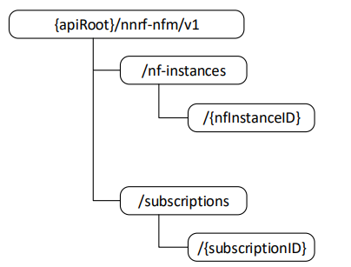
Key Technologies
Service-Based Architecture (SBA) & Service-Based Interface (SBI)
enables modularization and flexibility within network functions and their interactions.
The SBI use HTTP/2 protocol, which provide low latency, security, high efficiency, bidirectional communication among NF services.
Use JSON as the application layer serialization protocol.
A URI uniquely identifies a resource. In the 5GC SBI APIs the resource URI
structure is specified as follows:
{apiRoot}/{apiName}/{apiVersion}/{apiSpecificResourceUriPart}

Slide 6
Case Studies
Setting up 5G Core
with OAI UDR and NRF, AMF, SMF, UPF, UDM, AUSF from Open5gs
with OAI NRF and AMF, SMF, AUSF, UDR, UDM, UPF, AUSF from Open5gs
with OAI UDM and NRF, AMF,SMF, UPF, UDR, AUSF from Open5gs
with Open5gs NRF and AMF, SMF, AUSF, UDR, UDM from OAI

Slide 7
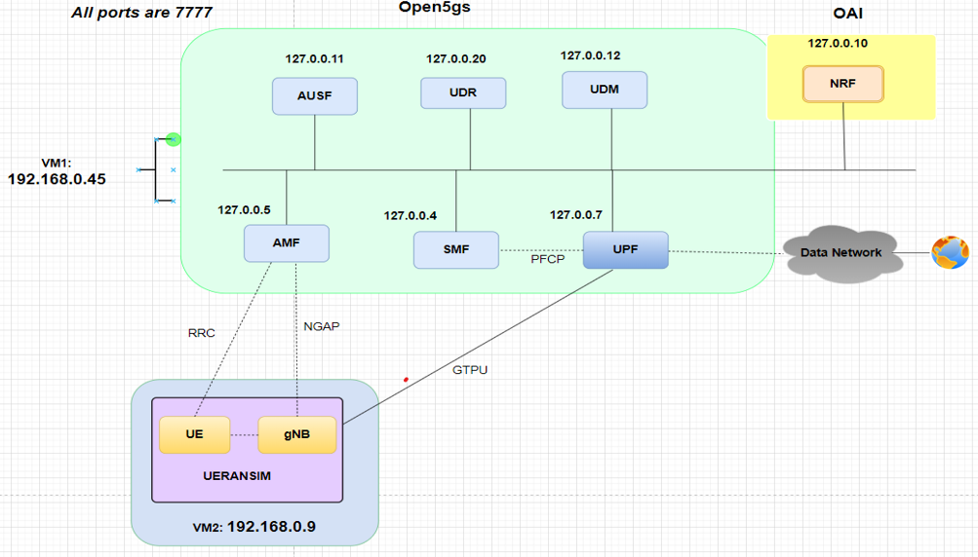
Case Study 1

Slide 8
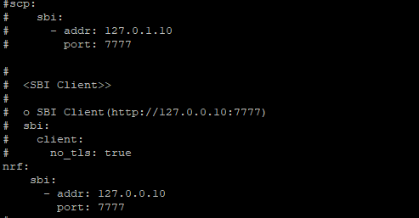
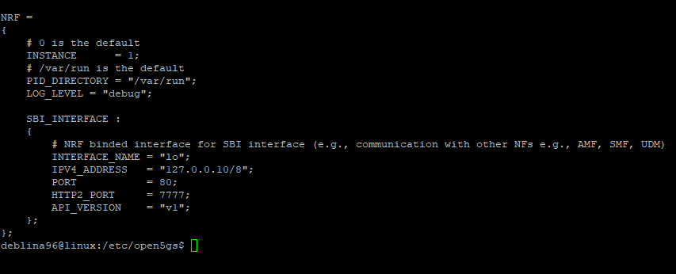
Specification:
Open5GS employs a Service Communication Proxy (SCP) to facilitate indirect communication, bypassing direct interaction with the NRF, unlike OAI which operates exclusively with NRF.
SCP was deactivated across all network function settings within Open5GS.
NRF was activated to enable direct communication.
All Network Functions are configured to communicate via their own loopback addresses.
The setup for the OAI NRF is implemented.

Slide 9
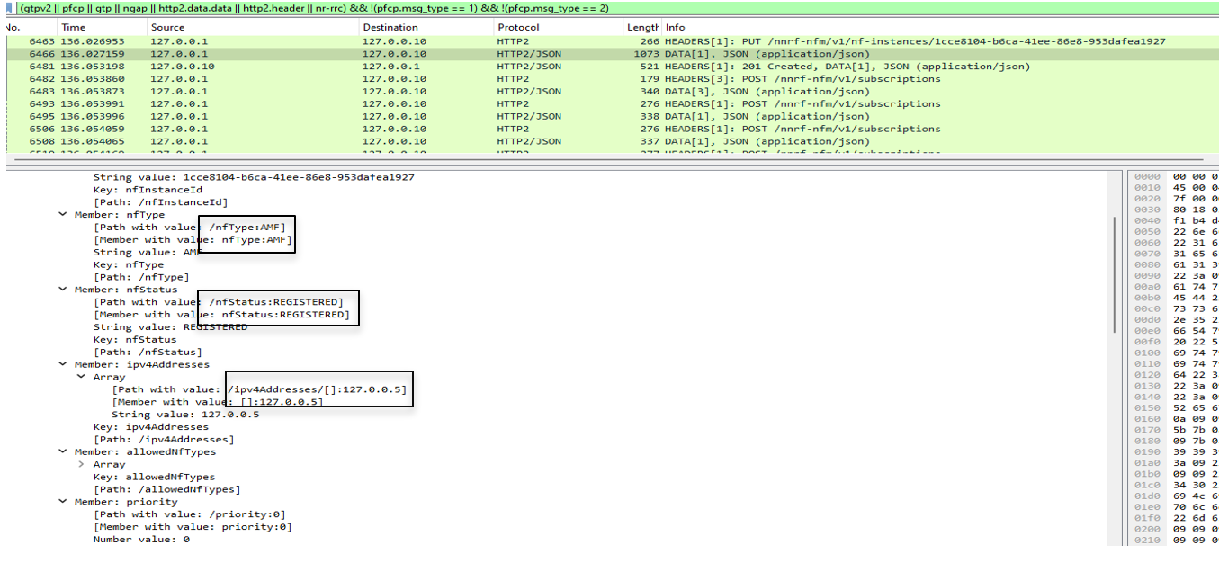
Outcome
Initial registration request to OAI NRF

Slide 10
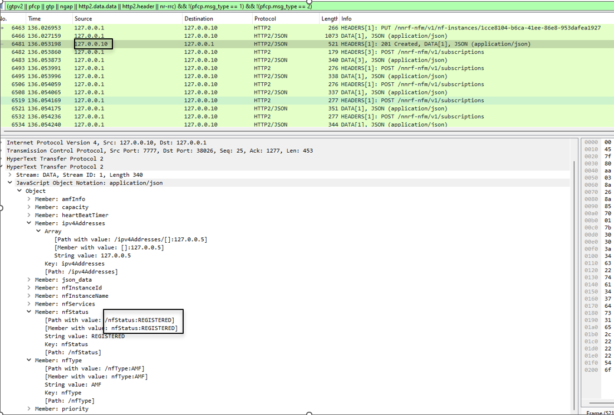
Outcome
Registration response from OAI NRF

Slide 11
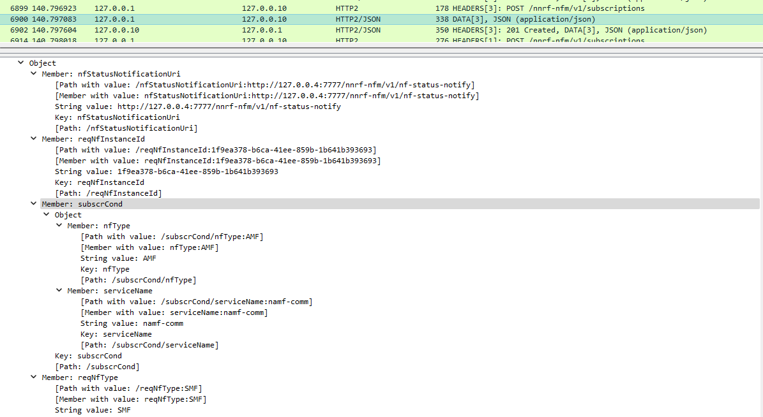
Outcome
Network Function subscription request to OAI NRF

Slide 12
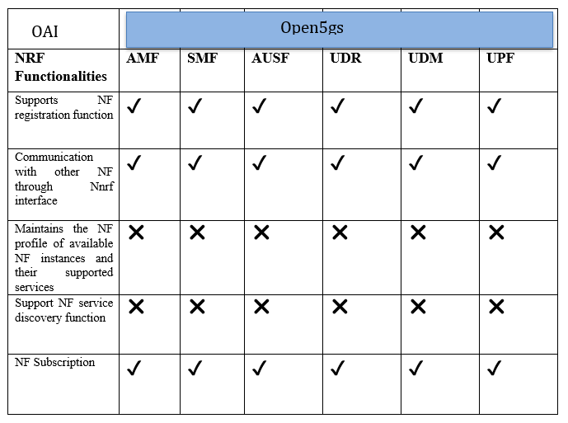
Realisation Matrix

Slide 13
Observation
Error in OAI NRF log, due to validation of SCP information, which is disabled.
SCP instances are accessed by the handle_scp_info() method in the source code (nnrf-handler.c), which results in errors.
Error with HTTP2 PATCH request was noted, indicating NRF's inability to update NF profiles.
Failure in NF Registration Update process, NFs' attempts to stay registered via the HEARTBEAT mechanism with HTTP2 PATCH requests are unsuccessful, as the OAI NRF responds with "400 Bad Request".
Failure in UE Registration, as AMF is unable to locate AUSF and UDM for authentication due to the inability of NRF to list NF profiles as "REGISTERED“ state.

Slide 14
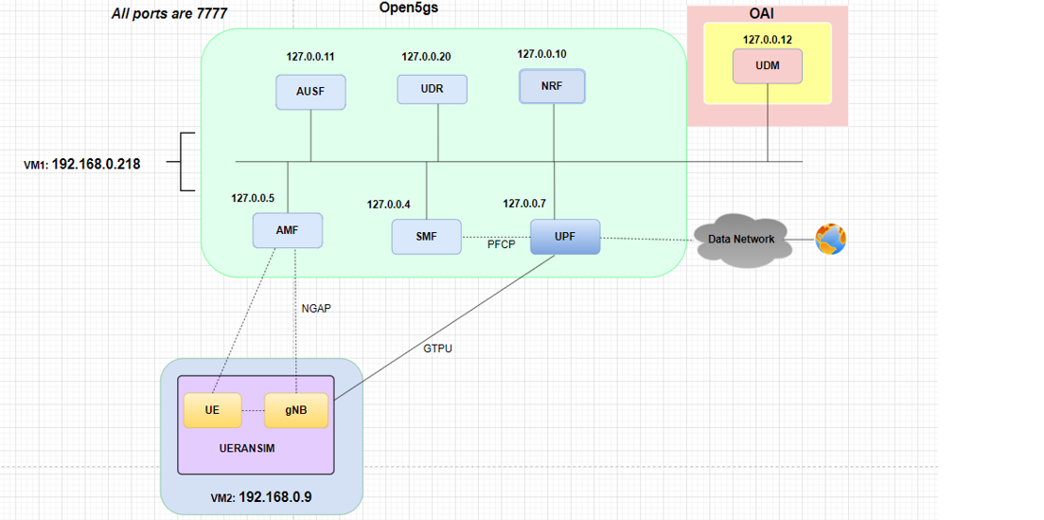
Case Study 2

Slide 15
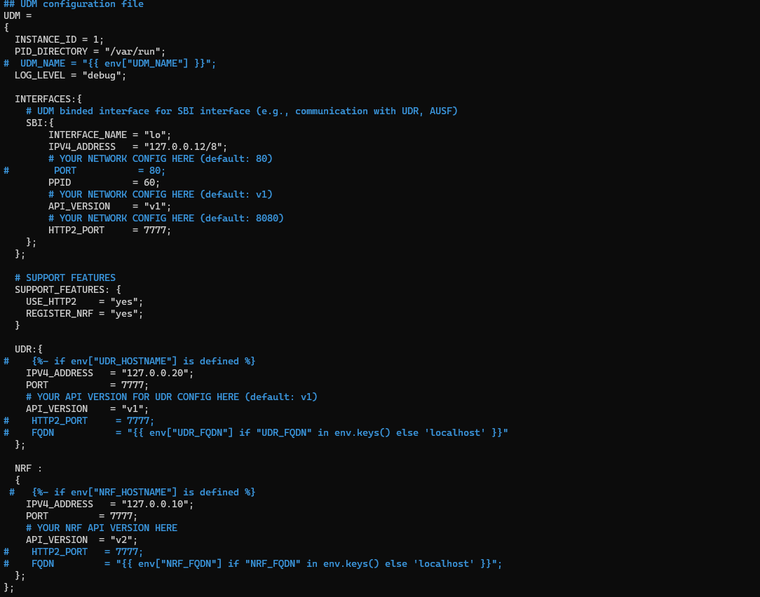
Specification:
Developed OAI-based UDM featuring two distinct configuration files.
Configuration files named config.yaml and udm.conf are created.
udm.conf is the chosen file for this specific setup.
UDM is set to communicate with UDR and NRF on the same machine via HTTP/2 protocol.

Slide 16
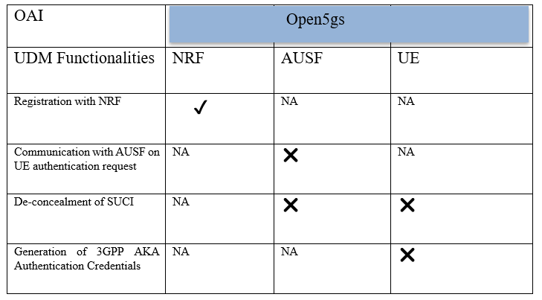
Realisation Matrix

Slide 17
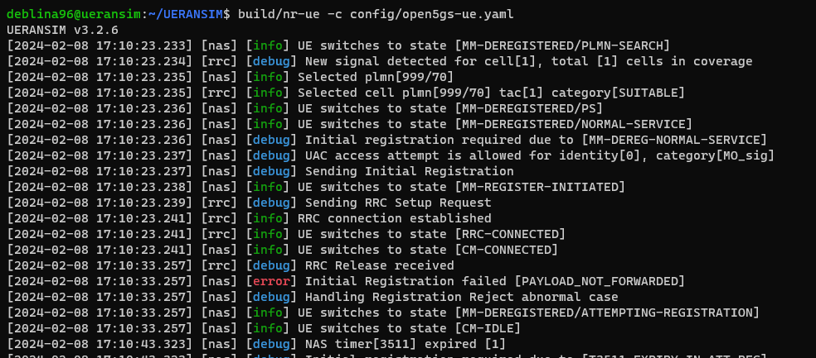
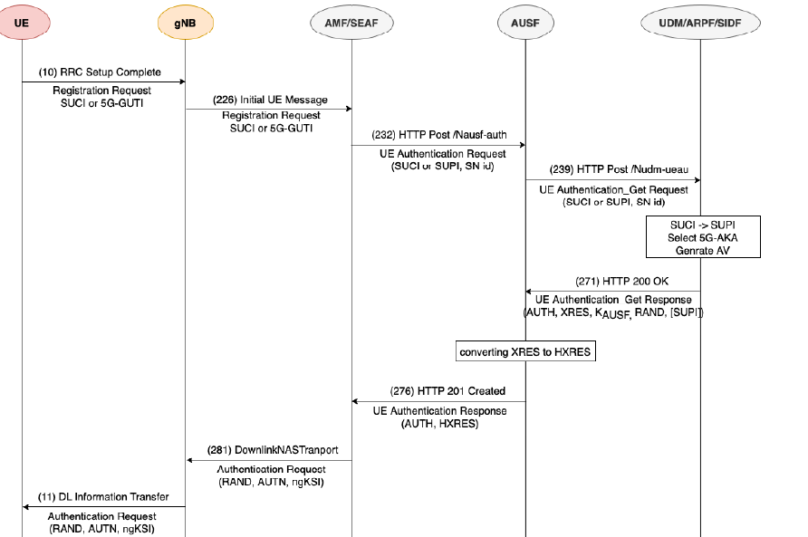
Observation
AUSF is unable to locate the “nudm-ueau:AUSF” service using the NF-discover function.
Failure in HTTP/2 Get request, sent to NRF for retrieving information about AUSF.

Slide 18
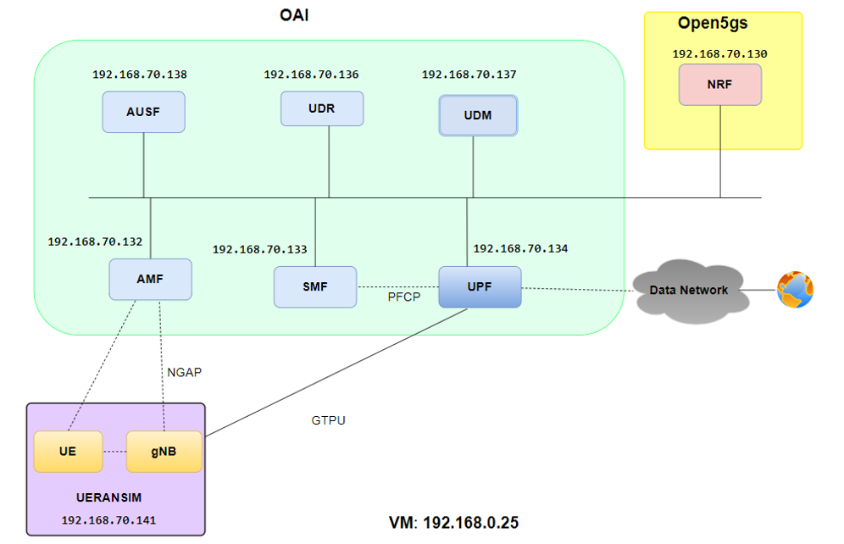
Case Study 3

Slide 19
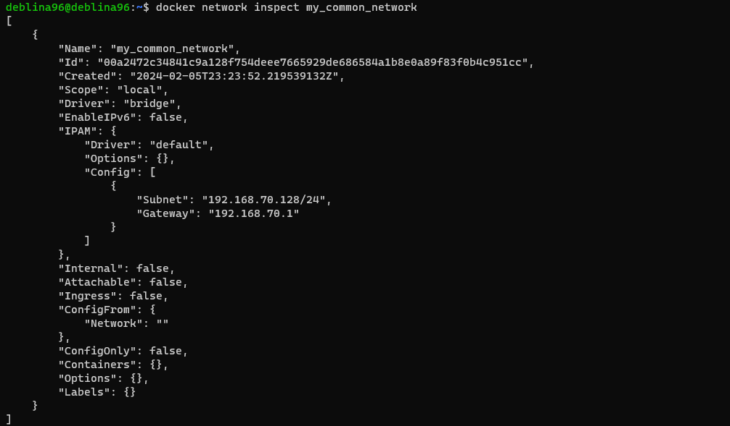
Specification:
Developed in a containerized setup utilizing Docker and Docker Compose.
Developed custom external network for facilitating communication between containers across different project.
Deployment of containers through different scripts for different Docker Compose file.

Slide 20
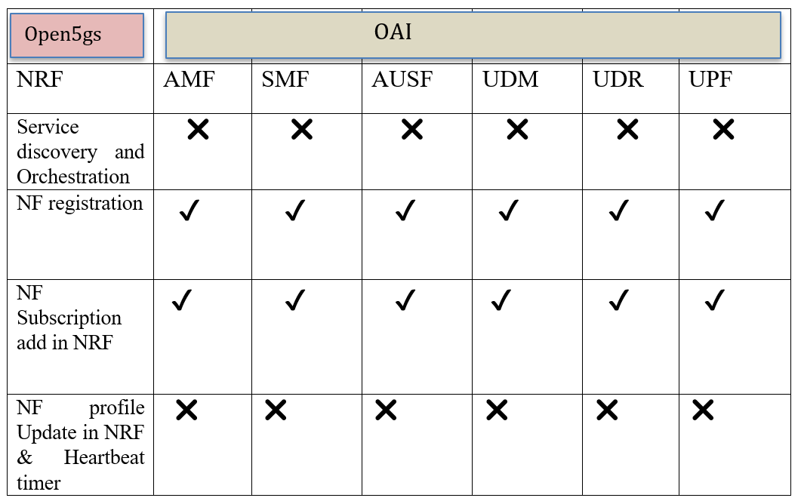
Observation and Realisation
Failure of “OpenAPI_nf_profile_parseFromJSON()” function in source code as it is unable to identify nf_instance_id .
When OAI NF sends a PATCH request to Open5gs NRF with a JSON payload, Open5gs fails to recognize the nf_instance_Id.
The nf_instance_id is generated by OAI using a UUID (Universally Unique Identifier) function, leading to parsing errors in Open5gs.

Slide 21
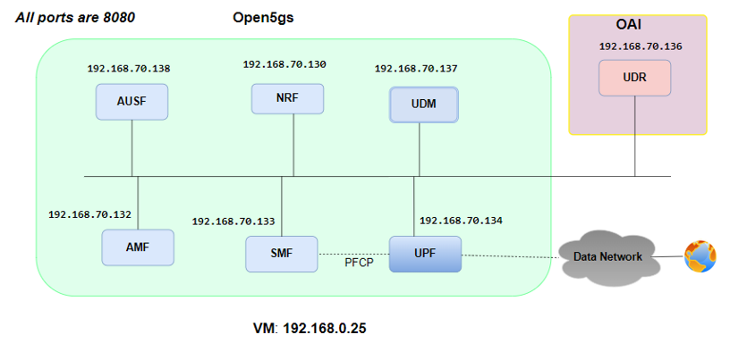
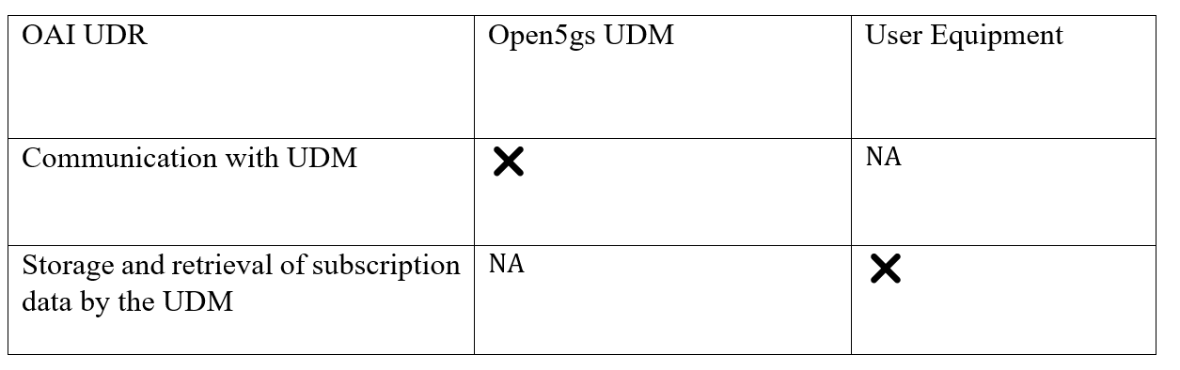
Case Study 4

Slide 22
Overall Analysis
Certain level of interoperability achieved at the initial stage.
NFs from one distribution was able to register with NRF from another distribution and add the subscription to NF status .
Incompatibility in heartbeat mechanism between different source-source projects.
NF Service Consumers send a PATCH request using resource URI to NF service producer using same NF Instance and Instance ID generated earlier through HTTP2 PUT request.
NRF could not recognize the JSON payload and unable to process the request due to the mismatch in JSON payload format.
Consequently, send “400 bad request”.
After initial registration, further chances for communication among different NFs are lacking.

Slide 23
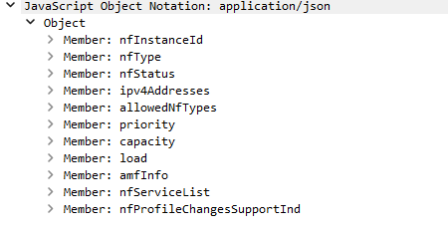
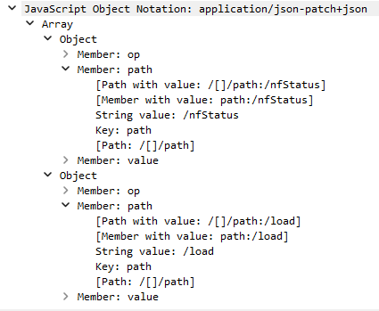
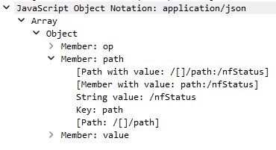
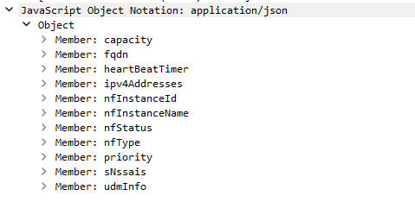
JSON Format across different distribution:
HTTP/2 PUT Request:
HTTP/2 PATCH Request:
Open5gs
OAI

Slide 24
Future Prospective
JSON data synchronization in different distribution.
By synchronizing JSON data across diverse distributions, there is a new potential for the NRF to process the PATCH request originating from an alternate open-source project.
Resultant bring compatibility with the Heartbeat mechanism.
Non-containerized environments offers more flexibility in testing and integration scenarios

Slide 25


